Slide 1
Component Based Design
Instructor: Mehroze Khan

Slide 2
Design Methodology
We have an
abstract description of a solution to our customer’s problem
a software architectural design
a plan for decomposing the design into software units and allocating the system’s functional requirements to them
No distinct boundary between the end of the architecture-design phase and the start of the module-design phase
No comparable design recipes for progressing from a software unit’s specification to its modular design
The process taken towards a final solution is not as important as the documentation produced
Design decisions are periodically revisited and revised
Refactoring
to simplify complicated solutions or to optimize the design

Slide 3
Design Documentation
The details of the system architecture is documented in Software Architecture Document (SAD)
SAD serves as a bridge between the requirements and the design
Program (or module) design acts as a bridge from architecture design to code
Many ways to document the design
Design by contract: a particular approach that uses the documentation not only to capture the design but also to encourage interaction among developers

Slide 4
Design by Contract
In design by contract, each module has an interface specification that precisely describes what the module is supposed to do
Meyer (1997) suggests that design by contract helps ensure that modules interoperate correctly
This specification, called a contract, governs how the module is to interact with other modules and systems
Such specification cannot guarantee a module’s correctness, but it forms a clear and consistent basis for testing and verification
The contract covers mutual obligations (the preconditions), benefits (the postconditions), and consistency constraints (called invariants)
Together, these contract properties are called assertions

Slide 5
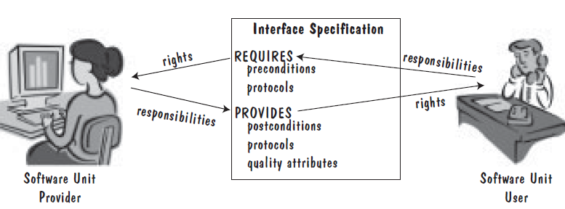
Design by Contract
Design Contract between software provider and user

Slide 6
Representing Design(Exercise) Sidebar 6.4 Royal Service Station Requirements of PFleeger
Royal Service station provides three types of services: refueling, vehicle maintenance, parking
The system must track bills, the product and services
System to control inventory
The system to track credit history, and payments overdue
The system applies only to regular repeat customer
The system must handle the data requirements for interfacing with other system
The system must record tax and related information
The station must be able to review tax record upon demand
The system will send periodic message to customers
Customer can rent parking space in the station parking lot
The system maintain a repository of account information
The station manager must be able to review accounting information upon demand
The system can report an analysis of prices and discounts
The system will automatically notify the owners of dormant accounts
The system can not be unavailable for more than 24 hours
The system must protect customer information from unauthorized access

Slide 7
Other Design Considerations Designing User Interfaces
Must consider several issues:
identifying the humans who will interact with the system
defining scenarios for each way that the system can perform a task
designing a hierarchy of user commands
refining the sequence of user interactions with the system
designing relevant classes in the hierarchy to implement the user-interface design decisions
integrating the user-interface classes into the overall system class hierarchy

Slide 8
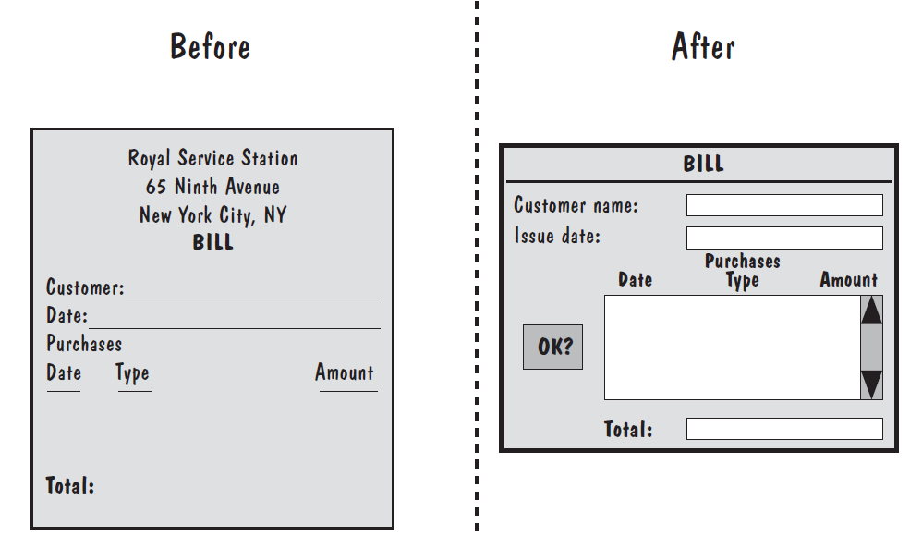
Other Design Considerations Designing User Interfaces
Notes:
We determine how paper flows in the existing system; the paper documents may suggest comfortable user interfaces in the automated system. For example, the lefthand side of Figure shows the paper bill that Manny uses at the Royal Service Station. Now, to automate his billing process, we may suggest a screen like the one on the right-hand side.

Slide 9
Component based Software Engineering
Components are higher-level abstractions than objects and are defined by their interfaces.
They are usually larger than individual objects, and all implementation details are hidden from other components.
Component-based software engineering is the process of defining, implementing, and integrating or composing these loosely coupled, independent components into systems.

Slide 10
Component based Software Engineering
Components are independent, so they do not interfere with each other’s operation.
Components communicate through well-defined interfaces.
Component infrastructures offer a range of standard services that can be used in application systems. This reduces the amount of new code that must be developed.

Slide 11
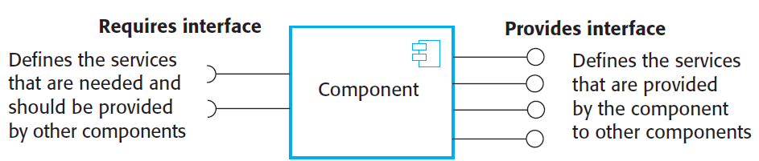
A Component with Interfaces

Slide 12
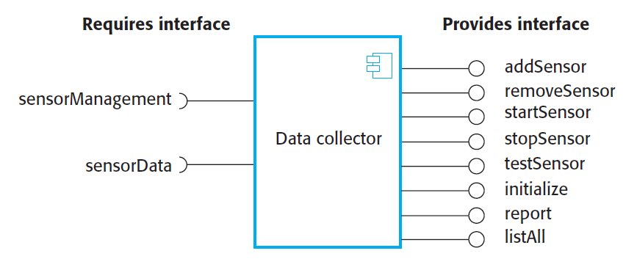
A Component with Interfaces
Notes:
The component diagram is helpful in representing the physical aspects of a system, which are files, executables, libraries, etc.

Slide 13
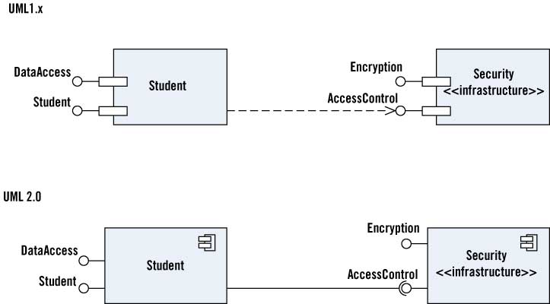
Component Diagram

Slide 14
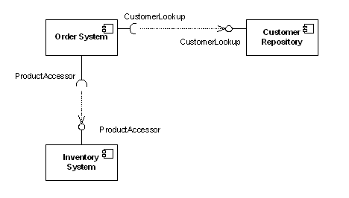
Example

Slide 15
Accident Management System (AMS)
Consider an accident management system where field officers (such as a police officer or a fire fighter) have access to a wireless computer that enables them to interact with a dispatcher. The dispatcher in turn can visualize the current status of all its resources, such as police cars or trucks, on a computer screen and dispatch a resource by issuing commands from a workstation. In this example, field officer and dispatcher can be modeled as actors.

Slide 16
AMS Decomposition
Dispatcher Interface Subsystem: user interface for Dispatcher
Field Officer Interface Subsystem: user interface for Field Officer
Incident Management Subsystem: creation, modification, and storage of Incidents
Resource Management Subsystem: tracking available resources (s.a. Fire Trucks, Ambulances)
Map Management Subsystem: depicting Maps and Locations
Notification Subsystem: implementing the communication between Field Officer terminals and Dispatcher stations

Slide 17
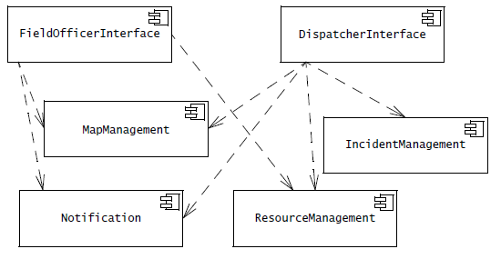
AMS Component Diagram

Slide 18
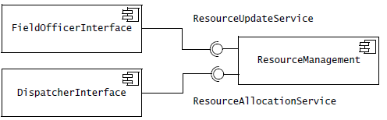
Services and Subsystems
Ball and Socket Notation

Slide 19
Subsystems
Subsystems are a type of stereotyped component that represent independent, behavioral units in a system.
Subsystems are used in class, component, and use-case diagrams to represent large-scale components in the system that you are modeling.
You can model an entire system as a hierarchy of subsystems.
You can also define the behavior that each subsystem represents by specifying interfaces to the subsystems and the operations that support the interfaces.

Slide 20
Decision Tracking System (DTS)
Consider a decision tracking system for recording design problems, discussions, alternative evaluations, decisions, and their implementation in terms of tasks. DesignProblem and Option represent the exploration of the design space: we formulate the system in terms of a number of DesignProblem and document each Option they explore. The Criterion class represents the qualities in which we are interested. Once we assessed the explored Options against desirable Criteria, we implement Decisions in terms of Tasks. Tasks are recursively decomposed into Subtasks small enough to be assigned to individual developers. We call atomic tasks ActionItems.

Slide 21
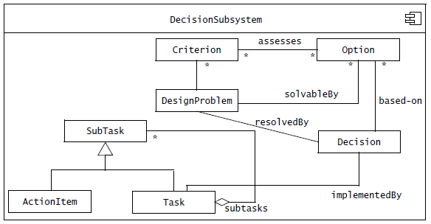
DTS Subsystem

Slide 22
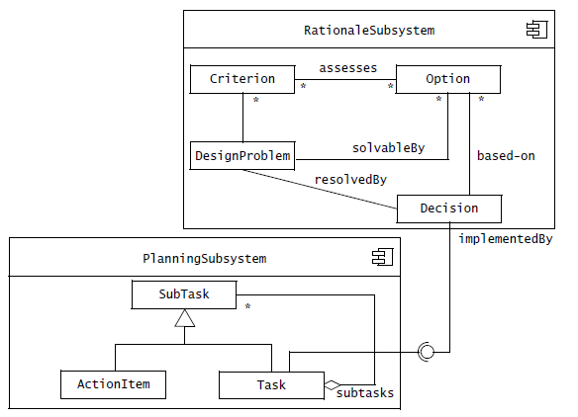
Component Diagram (Internal View)
Better Cohesion

Slide 23
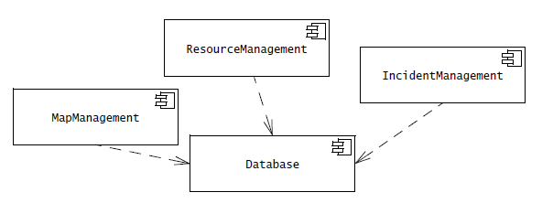
Coupling?

Slide 24
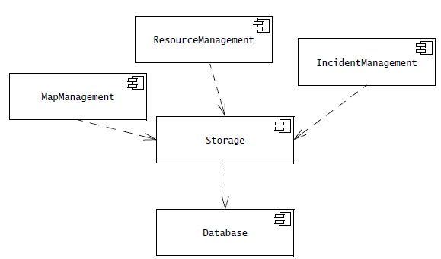
Coupling?

